Slide 1

National Institute of Technology,
Jamshedpur
Movie Recommendation System
B. Tech Project
Guided By : Mr. Ansuman Mahapatra
Presented by:-
Aditya Kumar (2014UGCS008)
Shikhar Kunal (2014UGCS078)
Shreya Bhhatacharya (2014UGCS081)

Slide 2
Index
Problem Statement
Related Works
Introduction to Recommender System
Types of Recommendation
Linear Regression
Neural Network
Proposed Work
Dataset description
Model design – Latent factor method
Simulation
Models
Analysis
Results
Conclusion
Future Work
References

Slide 3
Problem Statement
To design a Movie Recommender System that would predict the rating of a particular movie for a user and subsequently give suggestions of a list of movies that he/she is most likely to watch based on this rating.
Notes:
To design a Movie Recommender System using deep neural network
The main objective of this project is to develop a neural network model which will be trained on the basis of the training datasets and try to learn the interests and choices of the user on the previous ratings for different movies. The neural network will we henceforth tested of the validation dataset and the mean square error will be calculated. The benchmark is set at 0.90 which will be tried to improve the loss error.

Slide 4
Related Works
Many recommendation systems have been developed over the past decades.
These systems use different approaches like collaborative approach, content based approach, hybrid approach etc.
Looking at the purchase behaviour and history of the shoppers, Lawrence et al. 2001 presented a recommender system.
To find the potential customers most of the recommendation systems today use ratings given by previous users. These ratings are further used to predict and recommend the item of one’s choice.
In 2007 Weng, Lin and Chen performed an evaluation study which says using multidimensional analysis and additional customer’s profile increases the recommendation quality.
Weng used MD recommendation model (multidimensional recommendation model) for this purpose. multidimensional recommendation model was proposed by Tuzhilin and Adomavicius (2001).

Slide 5
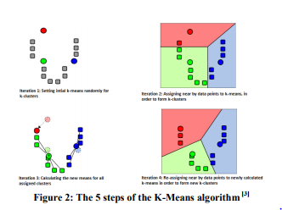
(Summary of the research points)
In this research paper, k means algorithm was used for clustering of related data.
The attributes used to calculate distance of each point from centroid are
Genre
Actor
Director
Year
Rating

Slide 6
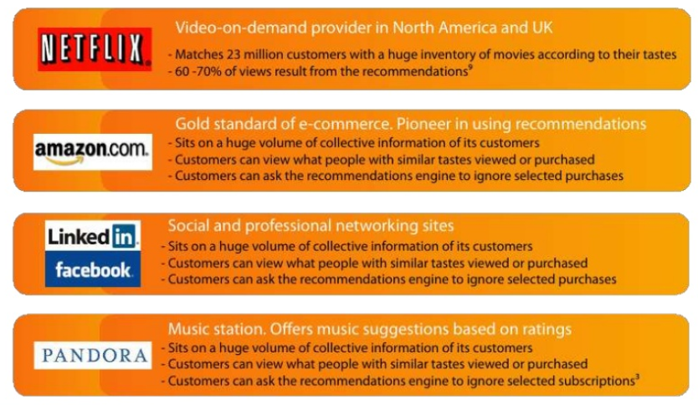
Introduction to Recommendation System
Recommendation system is an information filtering technique which provides users with information, which he/she may be interested in.
Notes:
Based on the users’ likes and movie history, the movie recommender system will give suggestions for similar kind of movies to watch.
Recommend many products from different categories based on what you are browsing and pull those products in front of you which you are likely to buy to lure you into buying the combo..
Increase average order value i.e., to up-sell and cross-sell customers by providing product suggestions based on the items in their shopping cart or below products they’re currently looking at on-site.

Slide 7
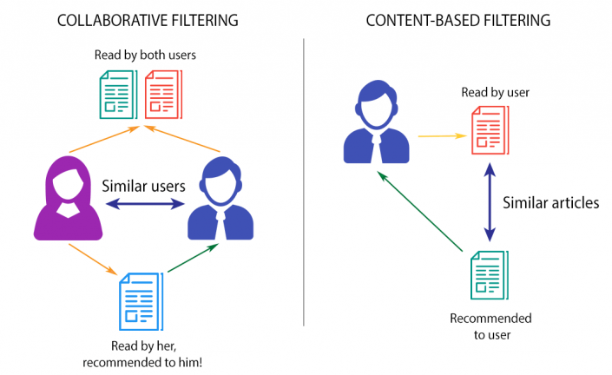
Types of recommendations
Collaborative filtering
Content based filtering

Slide 8
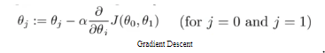
Linear Regression
Given a data set of n statistical units, a linear regression model assumes that the relationship between the dependent variable y and the p-vector of regressors x is linear.
Written in matrix notation as y= Xβ + E
Gradient Descent is a general function for minimizing a function, in this case the Mean Squared Error cost function

Slide 9

Neural Network
It is based on a collection of connected units or nodes called artificial neurons. Each connection between artificial neurons can transmit a signal from one to another. The artificial neuron that receives the signal can process it and then signal artificial neurons connected to it.
Notes:
PHASE 1:
-Propagation forward
-Calculation of the cost
-Propagation of the output activations back through the network and generate deltas.
PHASE 2:
Find gradient of weight by multiplying weight’s output delta and input activation
Subtract a ratio of weight’s gradient and update new weight.
We do the sum of products of inputs(X) and their corresponding Weights(W) and apply a Activation function f(x) to it to get the output of that layer and feed it as an input to the next layer.
Examples are:
Sigmoid function (σ): g(z) = 1 / (1 + e^{-z}).
Rectified Linear Unit (ReLU): g(z) = max{0, z}
Leaky Rectified Linear Unit: g(z) = max{α*z, z}.

Slide 10
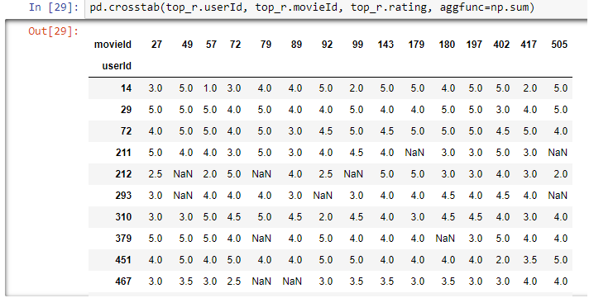
PROPOSED WORK
Let R be the ratings matrix with dimensions (num_users × num_items)
We generally have a few ratings, but most of the entries in the ratings matrix are generally missing.
The task at hand is to predict the missing entries in the ratings matrix R.

Slide 11
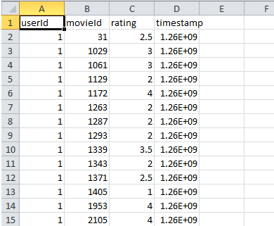
Dataset Description
We worked with the MovieLens dataset, which contains explicit ratings given by users to movies
The ratings for each movie are from 1 to 5
Dataset is randomly divided into 2 parts: the training set (80%)and the test set (20%)
Their description are listed below : ml-small -100004 ratings for 671 users and 9066 movies.
ml-100k - 100000 ratings by 943 users for 1682 movies.
ml-1m - 1000209 ratings by 6040 users for 3706 movies.(main dataset in our project. It is a stable benchmark dataset. It was released on 2/2003.)

Slide 12
Model Design – Latent factors
We have initialized an array of 50 elements for users and movies each to denote their features. These values are called Latent factors.
Every user has 50 values representing that user and similarly every movie has 50 values denoting that movie. These values tells us the criteria based on which a user gives ratings to a movies. They may denote the like of user towards different genres of movies like horror, action, romantic, comedy etc. Similarly for movies these values denote the type of a movie, how much the movie is horror or action etc.
To predict the rating of a movie for a user, the latent factors for movie and user are combined together as input and fed to the neural network.

Slide 13
Simulation:
First, Linear regression model was tested for our recommender system but it performed badly on the datasets. This is because the ratings are not linear functions.
Neural Networks are best suited for these types of scenarios.
We developed many models for testing. The 3 most significant ones are shown in the next slides.
These three models were run on different models for different batchsize and the results were plotted in graphs.
Notes:
We have pushed the code to github and all three of us contributed to it.

Slide 14
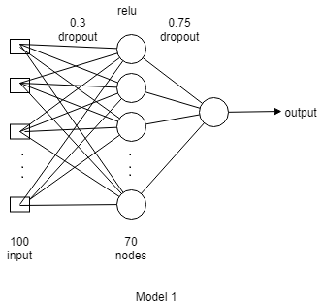
Models :
MODEL 1

Slide 15
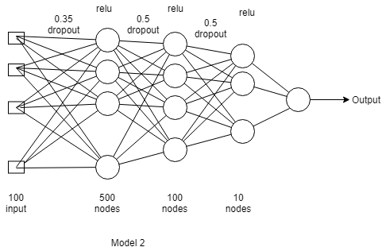
MODEL 2

Slide 16
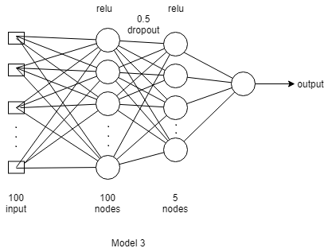
MODEL 3

Slide 17
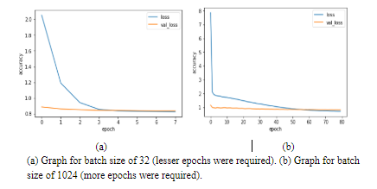
Analysis:
Increasing the batchsize leads to faster computation for one epoch but number of epochs have to be increased in that case to reach the optimal result. Hence, the batch size of 64 was found to be most appropriate for around 10 epochs.

Slide 18
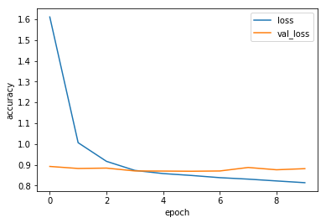
If the number of epochs are more than that required then it was found that the neural network tries to learn training set better but perform bad on test set. Increasing number of epochs to large number leads to overfitting of training data.
The result for Model 3 on ml_100k dataset for batch size of 64 and 10 epochs is shown in the graph below : We can see that after 4 epochs the neural network starts to overfit the training data.

Slide 19
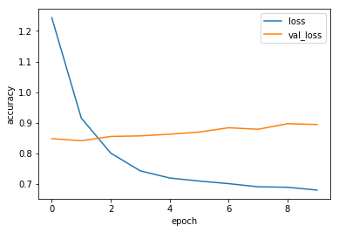
Lesser layer makes the model simple and perform good on small dataset but poor on large dataset. Large number of layers leads to more complex network and the model may overfit the training set in that case. Careful estimation of dropout regularization was required whenever there was chance of overfitting.
Using Model2 (having 3 hidden layers) on small dataset (ml_small) was found to overfit the training set data. The graph shown below was plotted for batch size of 64 and for 10 epochs.

Slide 20
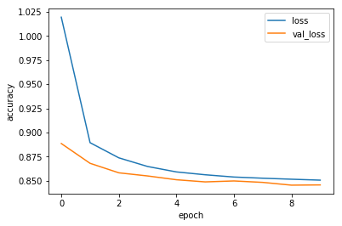
Model 3 was found to be the best suited passing the benchmark easily for all three datasets.
The graph for Model3 on ml-1m dataset for batch size of 64 and 10 epochs is shown below -

Slide 21
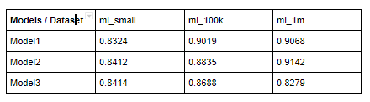
Results:
The best results for validation loss obtained for these models on the 3 datasets are tabulated below -
Model 3 gives best results
Notes:
We got the best val_loss value of 0.8279 as shown above.
As we can see above that our model beats the benchmark easily. We have improved the loss of our initial model from 0.9 to 0.82 which is very significant for large datasets.

Slide 22
Conclusion:
we presented a neural network model capable of predicting ratings of movies for different users.
Empirically, our model is able to achieve similar results to state-of-the-art collaborative filtering techniques. Compared with other models and benchmarks, our neural network achieves much lower loss when predicting unrated items. It is capable of modeling higher-order dependencies and nonlinearities in the data.

Slide 23
Future work
It is found that the data in the MovieLens data set and many similar data sets is well suited to using linear models. This may be due in part to the fact many of the data sets are inherently sparse and nonlinear models could overfit them and reduce their generalization. As a direction of future work, we are examining how to better incorporate the nonlinear component of the network.
We are also looking at integrating both user and item descriptions with latent input variables to address the new user problem and the new item problem in a single model.
We can increase the size of data for better training of our model and improve on its result.
This model can also be used for other prediction systems with little modification.
This model can be combined with sentimental analysis system for the comment section of movies to improve the results further.

Slide 24
References
[1] F. Maxwell Harper and Joseph A. Konstan. “The MovieLens Datasets: History and Context”. In: ACM Trans. Interact. Intell. Syst. 5.4 (Dec. 2015), 19:1–19:19. Issn: 2160-6455. doi: 10.1145/2827872. url: http://doi.acm.org/10.1145/2827872.
[2] T. M. Mitchell. Machine Learning, volume 1. McGraw-Hill New York, 1997.
[3] R. D. Burke. Hybrid recommender systems: Survey and experiments. User Modeling and User-Adapted Interaction, 12(4):331–370, 2002
[4] MMDS course slides; Jeffrey Ullman; http://infolab.stanford.edu/ ullman/mmds/ch9.pdf
[5] Michael S. Gashler Ph.D. A Hybrid Latent Variable Neural Network Model for Item Recommendation; https://arxiv.org/pdf/1406.2235.pdf
[6] Francesco Ricci et al. Recommender Systems Handbook. 1st. New York, NY, USA:
Springer-Verlag New York, Inc., 2010. isbn: 0387858199, 9780387858197.
[7] E. Vozalis and et al. Analysis of Recommender Systems’ Algorithms.

Slide 25
THANK YOU

